Slide 1
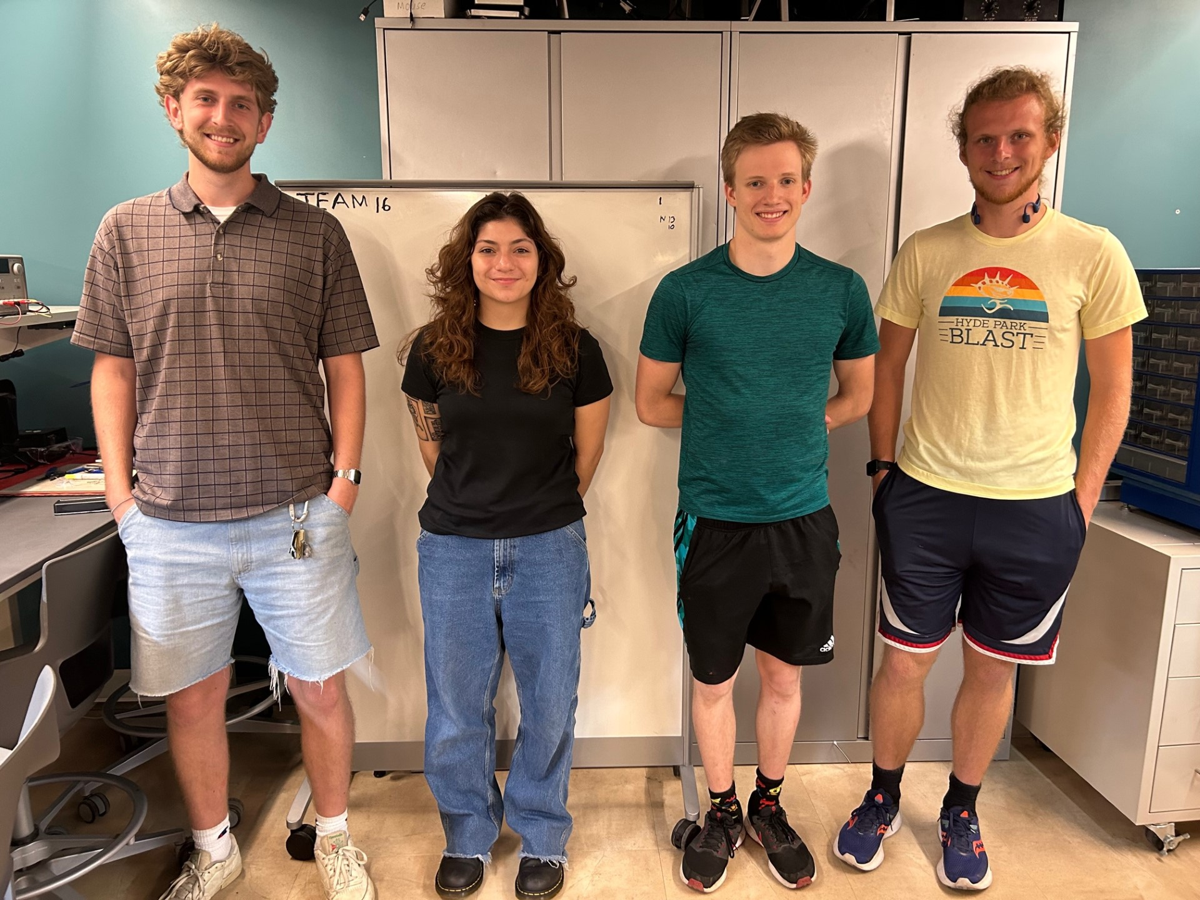
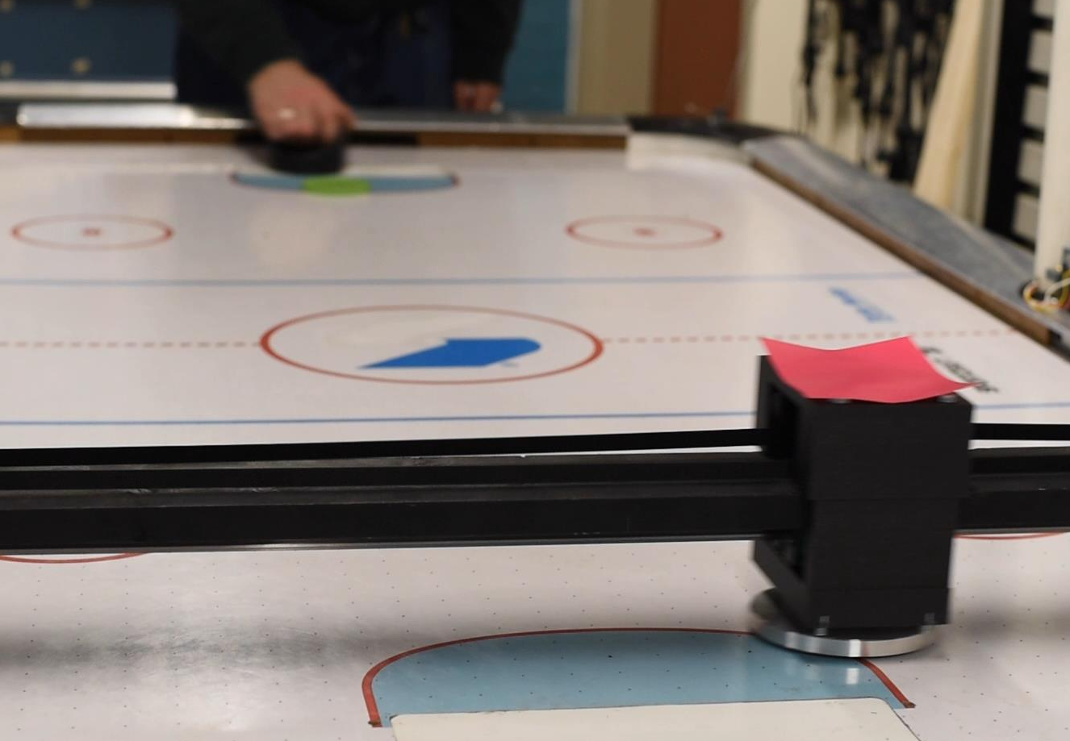

ECE 477 FINAL REVIEW: TEAM #16 Autonomous Air Hockey

Slide 2
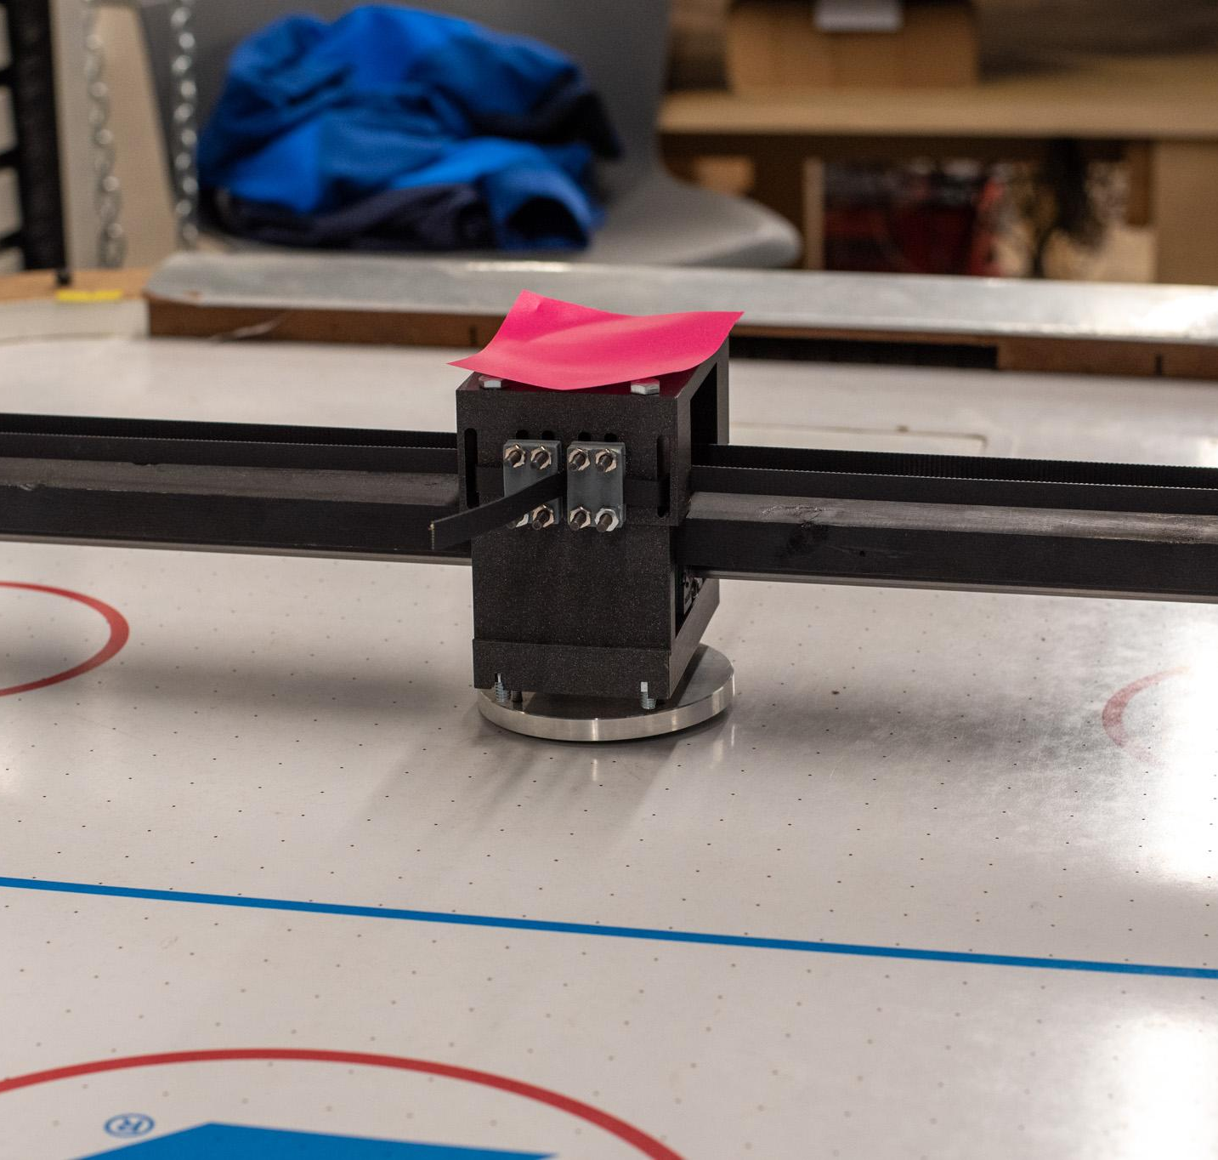
OUTLINE
Project Overview
Block Diagram
Design Challenges
Individual Contributions
Project Video Demonstration
Questions

Slide 3
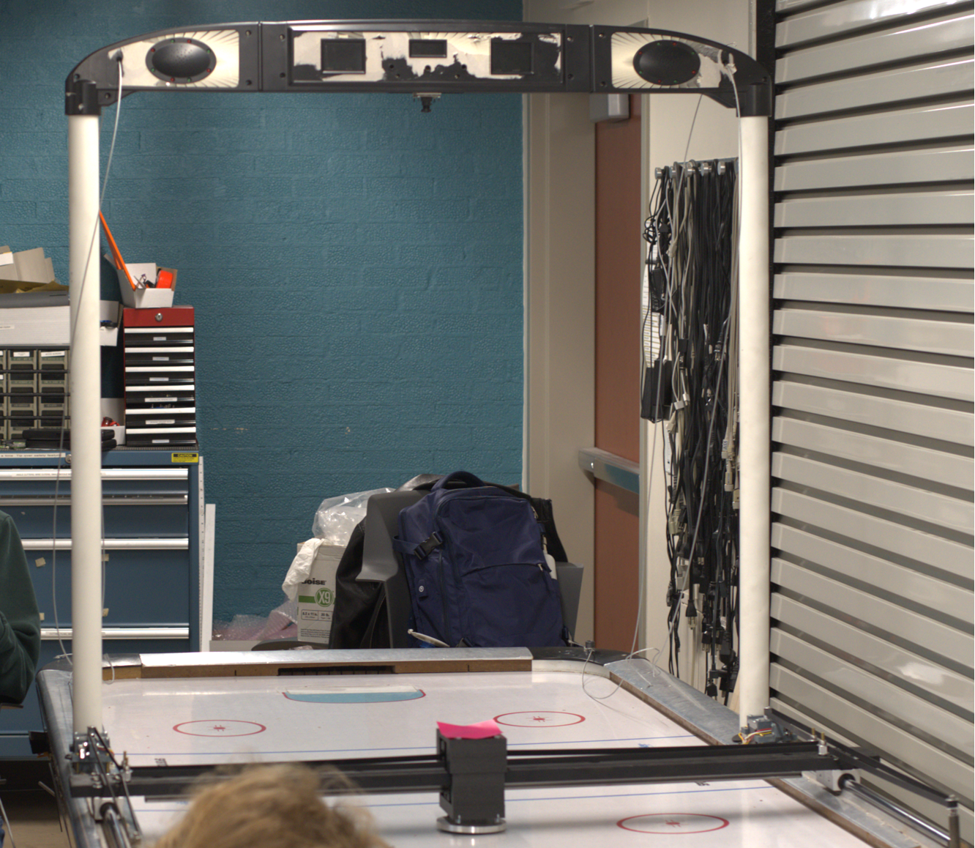
PROJECT OVERVIEW
Autonomous Air Hockey Robot
An autonomous robot capable of playing a human player in air hockey
Designed to support individualized training for air hockey hobbyists and enthusiasts
Camera
Scoreboard
Stepper Motors
Mallet
Notes:
abby - 2 min

Slide 4
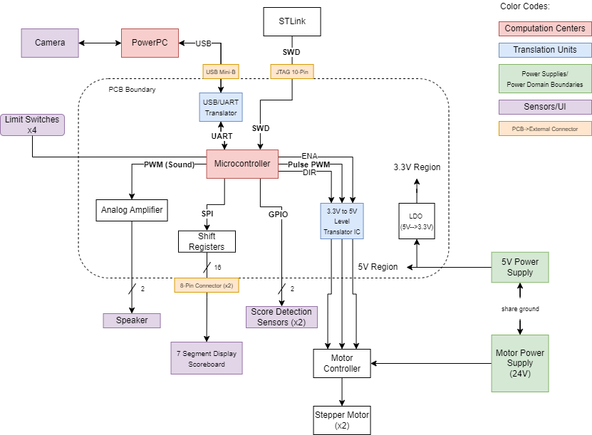
BLOCK DIAGRAM
Notes:
joey - 1 min

Slide 5
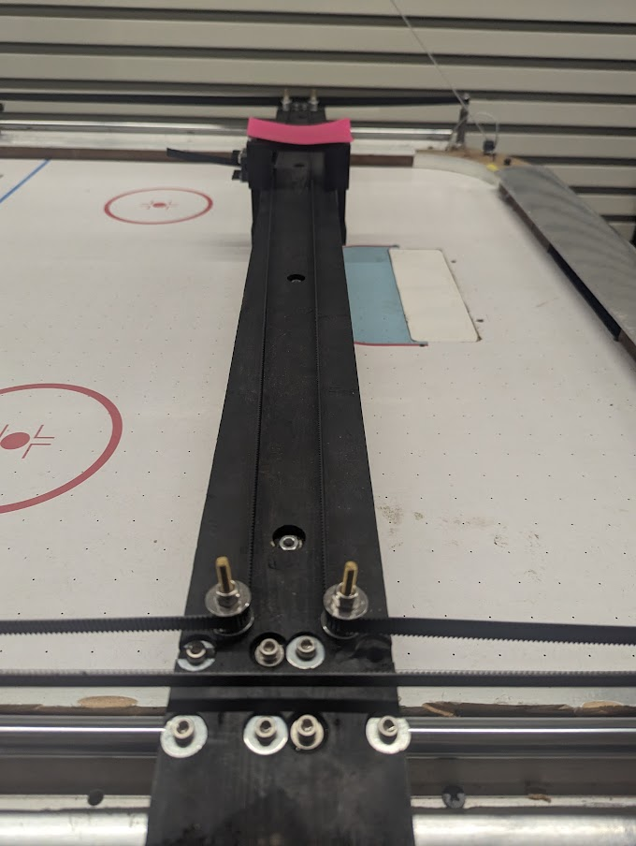
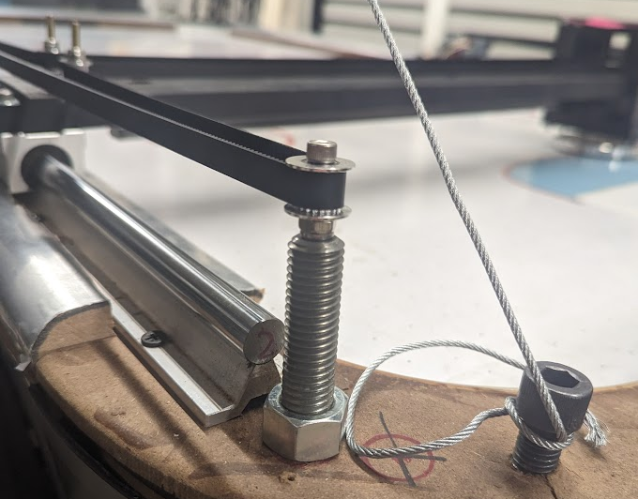
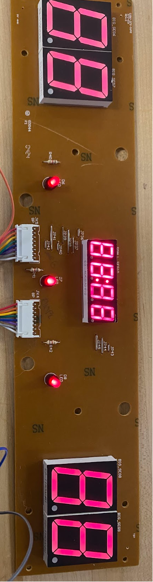
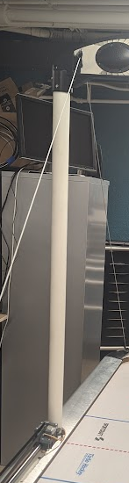
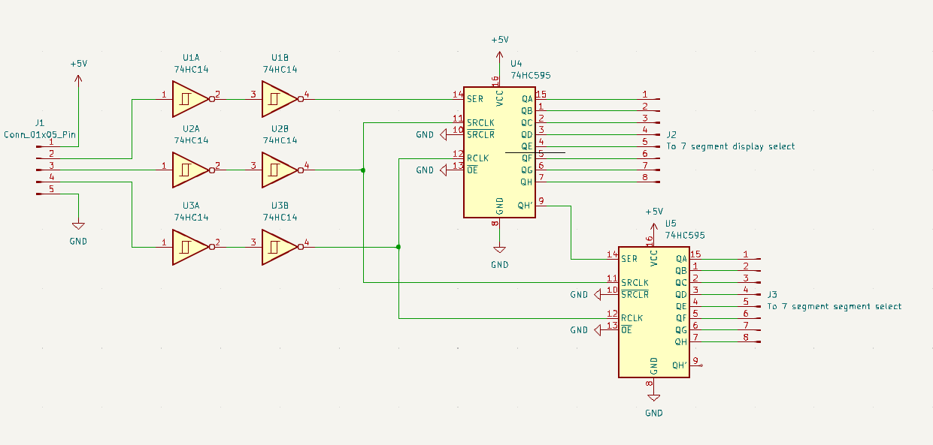
DESIGN CHALLENGES
Main Design Challenges
7-Segment Display
Signal integrity with long wires
Mechanical constraints
Bending of end pulleys
Uneven surface of table
Electrical constraints
Overcurrent
Speed
Notes:
cameron - 1-2 min
In this section, detail major design challenges your team faced in developing your project. These could be conceptual challenges, such as fitting a complex design into a small form factor. Alternatively, these could be implementation challenges, such as difficult hardware and software errors which took many many hours to debug.

Slide 6
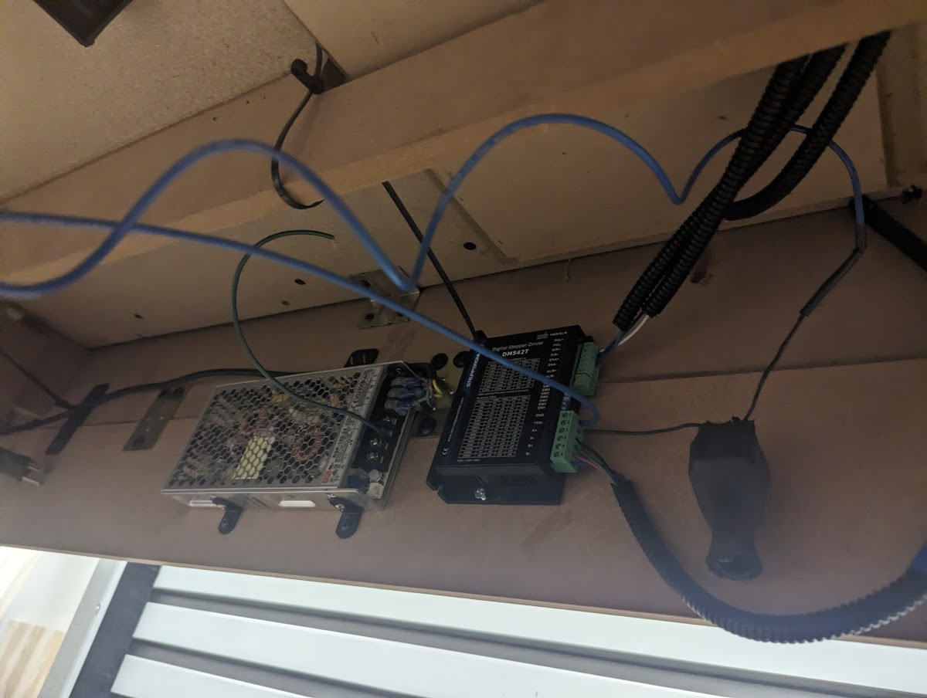
DESIGN CHALLENGES
Main Design Challenges
7-Segment Display
Signal integrity with long wires
Mechanical constraints
Bending of end pulleys
Uneven surface of table
Electrical constraints
Overcurrent
Speed
Notes:
cameron - 1-2 min
In this section, detail major design challenges your team faced in developing your project. These could be conceptual challenges, such as fitting a complex design into a small form factor. Alternatively, these could be implementation challenges, such as difficult hardware and software errors which took many many hours to debug.

Slide 7
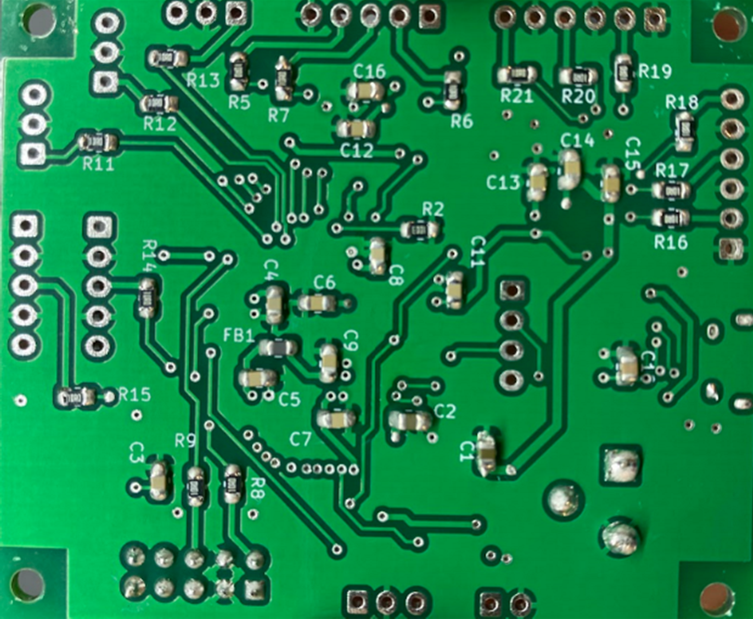
INDIVIDUAL CONTRIBUTIONS
Abby Haluska
Team Leader
Main focus: Embedded software
Communication via UART
All code uploaded to PCB
Other contributions:
Project/team organization
3D printing
PCB assembly

Slide 8
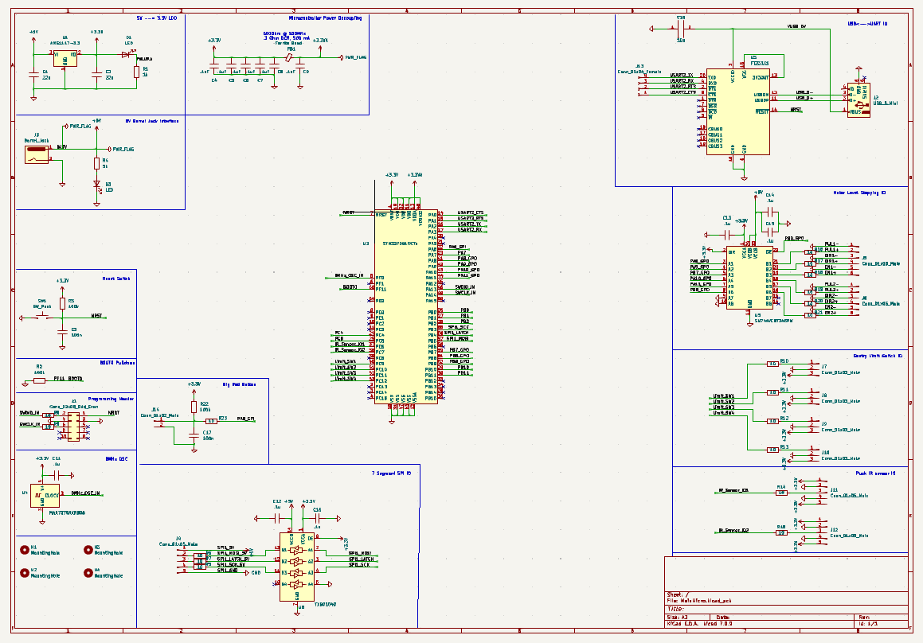
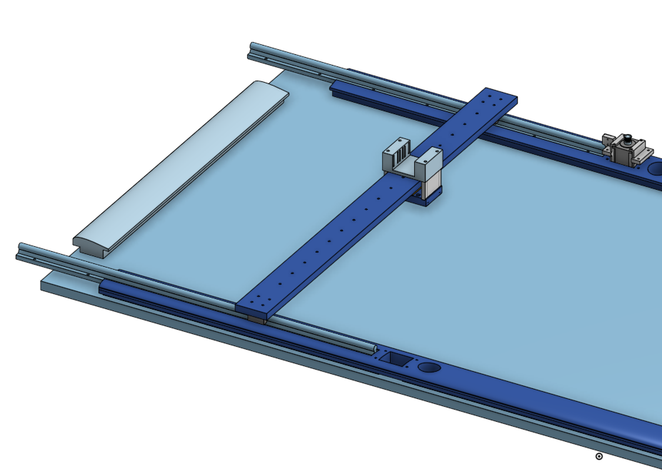
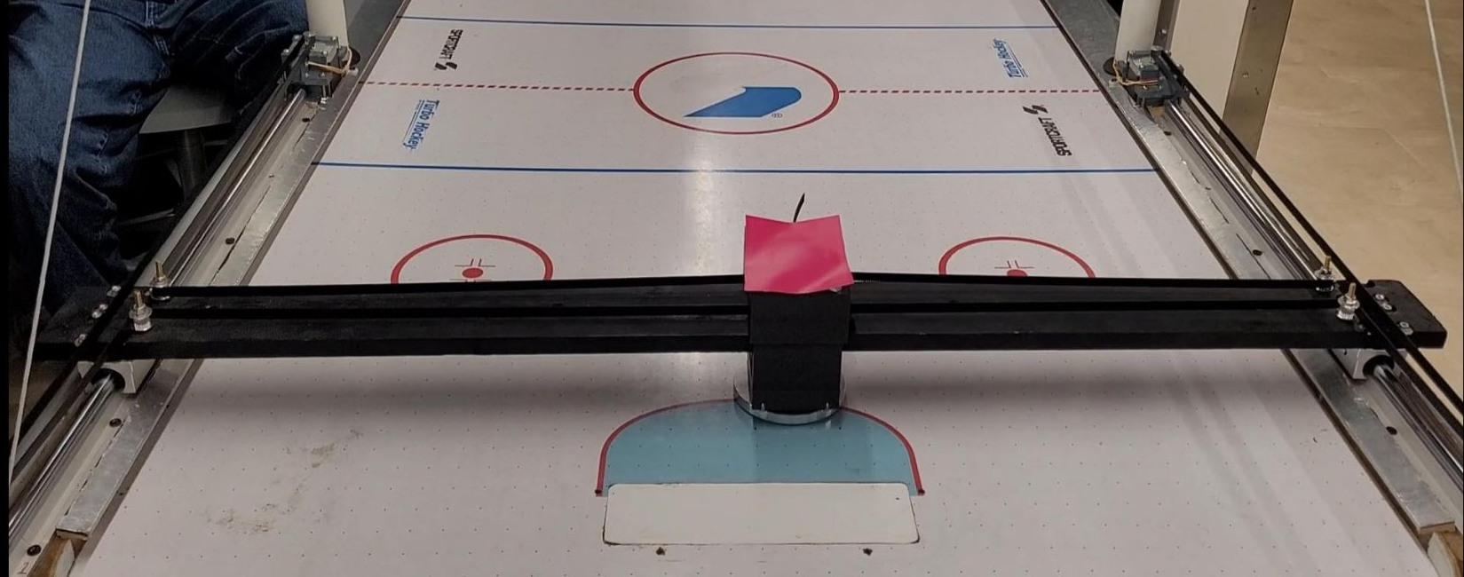
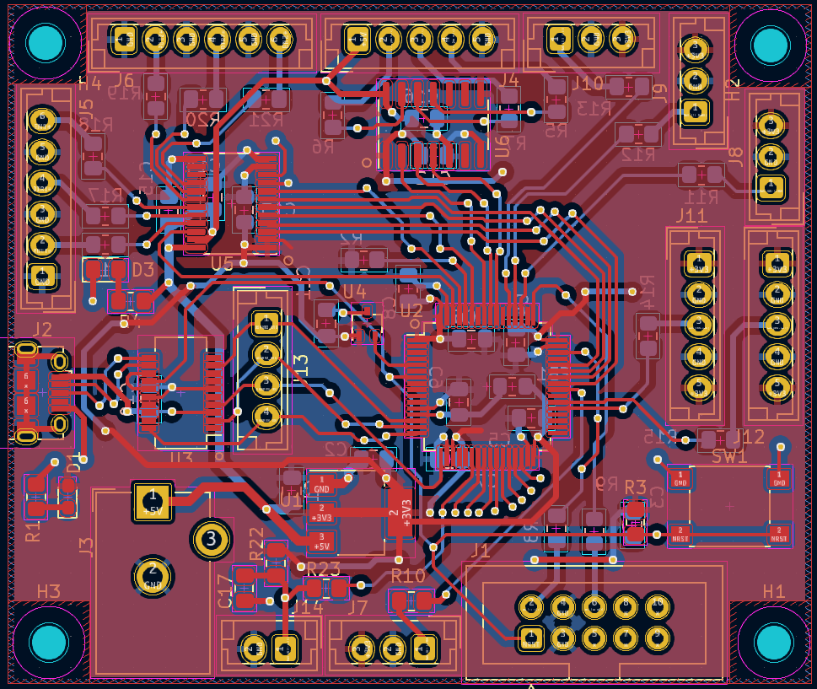
INDIVIDUAL CONTRIBUTIONS
Cameron McCutcheon

Slide 9
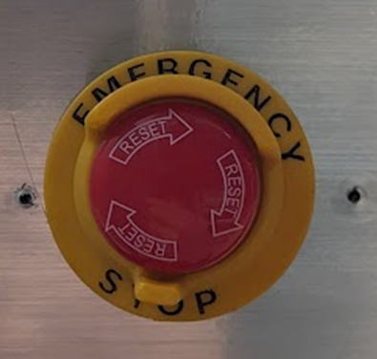
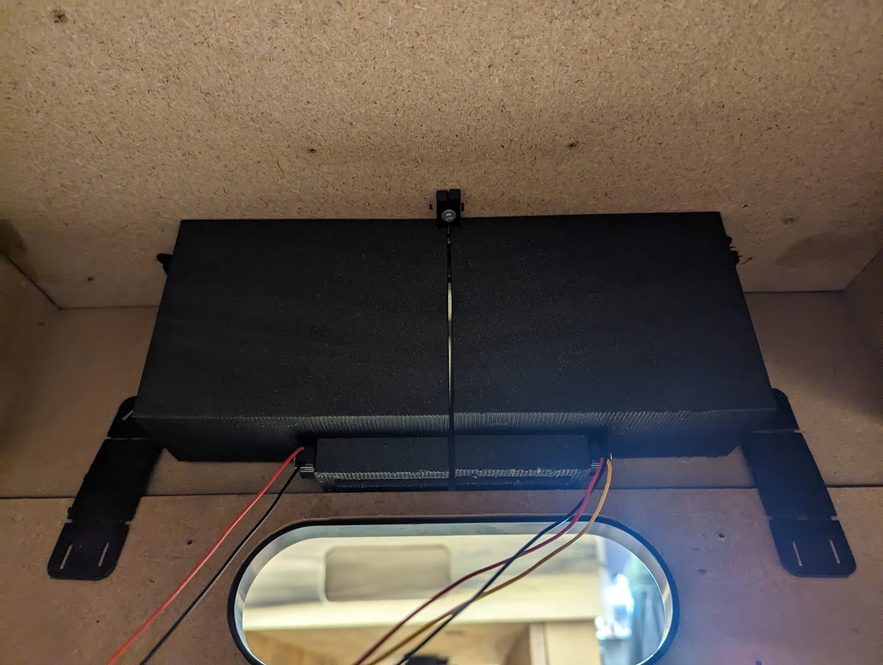
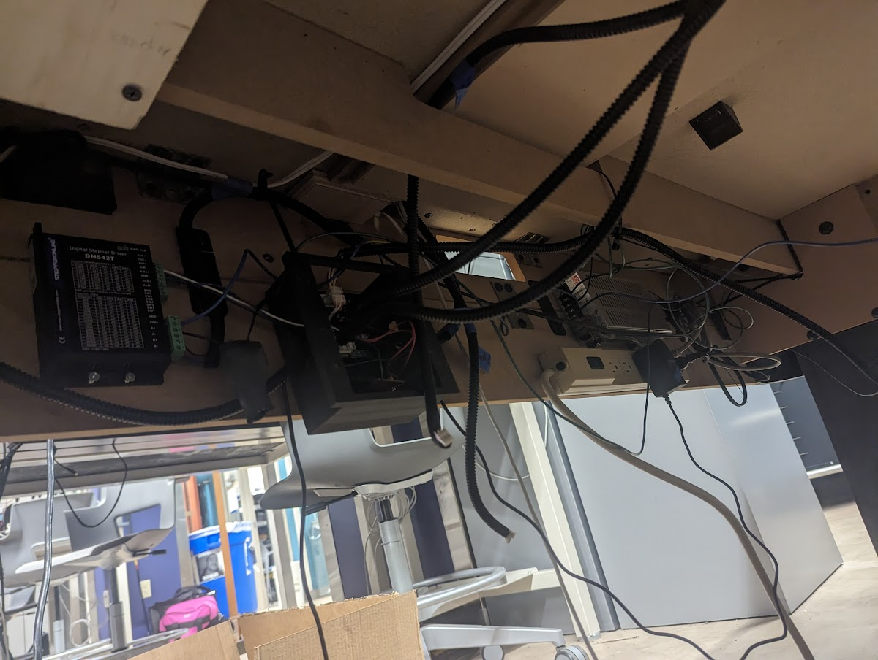
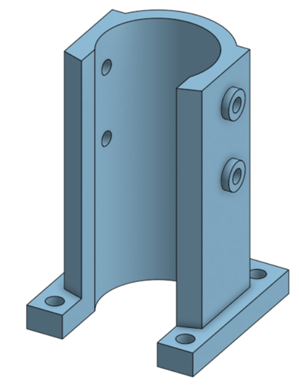
INDIVIDUAL CONTRIBUTIONS
John Morton
Packaging, Safety, and Wiring

Slide 10
INDIVIDUAL CONTRIBUTIONS
Joey Collins
Software Engineer
Main Focus: Visual Analysis Software
Puck and Mallet Tracking
Future Location and Trajectory Predictions
Other Contributions:
Embedded Software Debugging
Some PCB Assembly

Slide 11
PROJECT DEMONSTRATION
PSDR #1(Hardware): An ability to use a microcontroller to control the XY directions of a gantry system using PWM and 2 motors.
PSDR #2(Hardware): An ability to interface with an IC to establish communication and send data between a microcontroller and a PC via UART.
PSDR #3(Hardware): An ability to interface a seven-segment display scoreboard with shift registers.
PSDR #4 (Hardware): An ability to keep score with a microcontroller by counting the number of times an interrupt is triggered by a puck passing through an infrared laser beam.
PSDR #5 (Software): An ability to estimate the position and trajectory of a puck in motion using computer vision.
Notes:
List your PSDRs in the space below, but do not read them during the presentation. After this slide, show your demonstration video of your project in action. Show major features and all your PSDRs working. (1080p 16:9 HD is recommended).

Slide 12
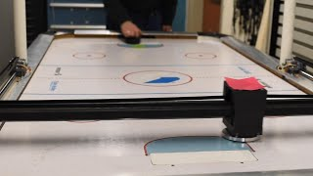
PROJECT DEMONSTRATION VIDEO

Slide 13
Questions?

